Slide 1
The New Risk Management: The Good, the Bad, and the Ugly
Authors: Philip H. Dybvig
Pierre Jinghong Liang
William J. Marshall
Lea Li

Slide 2
Purpose
Outline
Provide an introduction to the new risk management and some policy choices firms should be considering
Discussion of option-pricing tools
Example of how the new risk management ought to work
Implementation issues including general policy questions and accounting issues

Slide 3
Risk Management
Concept
Old Concept: buying corporate insurance, implementing procedures to avoid lawsuits and accidents, and installing safety equipment
New concept: using financial markets to hedge against the risk of changes in interest rates, input prices, or currency fluctuations
The good, the bad and the ugly
Essential for competition
Wasting resources without reducing risk
Generating larges losses

Slide 4
Option – Pricing Tools
Black-Scholes Model
Investment = the model’s option price, terminal value = terminal value of the option
Intuition is that we can replicate the risk of holding the option by holding just the right portfolio of riskless bonds and the underlying stock
Main assumptions: the absence of arbitrage, constant riskless rate, continuous stock prices, and constant variance of returns per unit of time for the underlying stock

Slide 5
Option – Pricing Tools
Black-Scholes Formula for the price of a call option
C = S N(x1) – B N(x2)
Where x1 = log (S/B)/s + s/2, x2 = log (S/B)/s - s/2
S is the stock price, B is the price of the bond promising to pay the amount of the strike price at maturity date of the option, C is the Black-Scholes price of the call option
s is the standard deviation log of the stock rice at maturity, given the stock price today, the function N() is the cumulative normal distribution function.

Slide 6
Risk Management In Manufacturing

Slide 7
Risk Management In Manufacturing

Slide 8
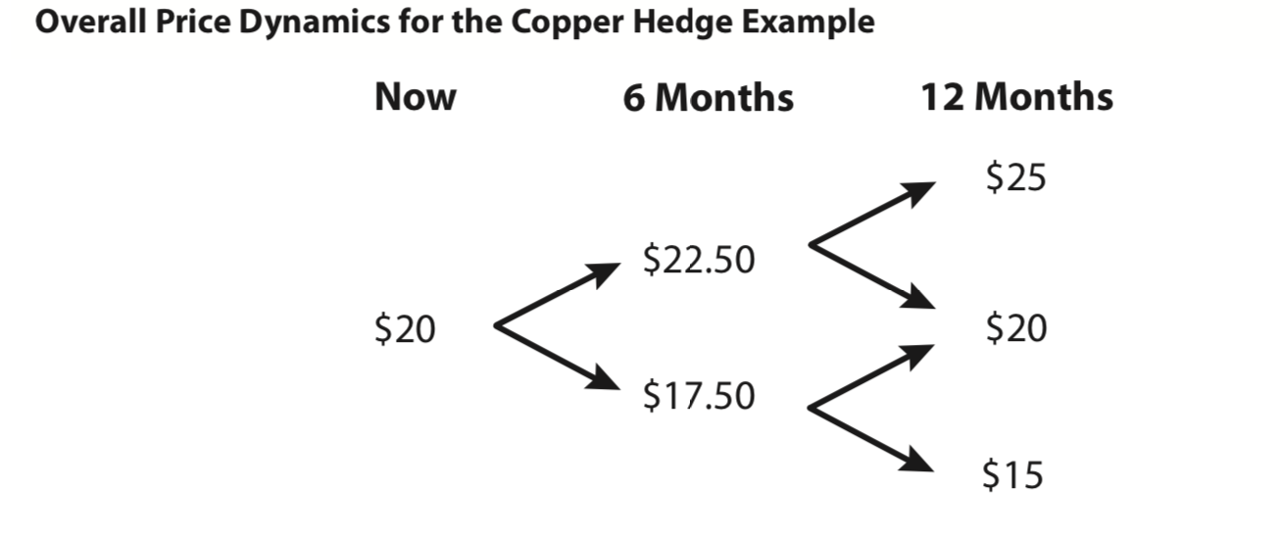
The Dynamic Hedge

Slide 9
The Dynamic Hedge

Slide 10
Potential Motives For Hedging
Why we hedge?
Maintain more leverage to reduce corporate taxes and avoid “double taxation”
Reduce earnings volatility
Easier to give managers incentives to produce profits
What risks should we hedge?
Hedge direct interest mismatch of existing assets and liabilities or full economic value
Hedge cash flows or value

Slide 11
Potential Motives For Hedging
With what instruments should we hedge?
Bonds, repurchase agreements, treasury bond futures, swaps, caps or collars
Determined by pricing and transaction costs
How much to pay the investment banker?
Understand how hedge works and how much it should cost
Hire expert to monitor the prices being paid to investment banker

Slide 12
Accounting Issues
FASB – Financial Accounting Standards Board
SFAS (Statement of Financial Accounting Standard) No.133 : Accounting for Derivative Instruments and Hedging Activities.
Hedge Accounting Methods
Fair Value Hedge
Cash Flow Hedge

Slide 13
Accounting Issues – Accounting Challenge
Transactions’ effects on financial statements
Fair value of future contracts must correspond to market value
Prior to settlement of the futures, unrealized gains or losses do not affect net income
Economically equivalent hedges may have very different accounting treatments
Adoption of intrinsic value accounting
Inaccurate estimates of future cash flows

Slide 14
Cost Issues
Cost of any securities purchased in the hedge program
Transaction costs such as commissions, bid-ask spread, any internal costs of trading (hiring a trader or setting up accounting oversight)
Cost of hedging the alternative use of any capital tied up in investment or in margin or variation accounts
Marginal cost = Spot market price, when used as input for pricing the output

Slide 15
Risk Management Policy
Specify the goal and scope of any hedging activity
Dictate the degree of centralization and the control systems
Provide for oversight and evaluation of the effectiveness of hedging

Slide 16
Conclusion
Implementation of vague new accounting standards that require companies to describe their risk exposure
Development of internal controls and policies

Slide 17
Questions ?

